Slide 1

NBA Analysis
Kendall Sisk, Kim Kockenmeister, Raj Ramachandran, Jaimie Koshy

Slide 2
Table of Contents
Theme
Goal/Purpose
The Data
ETL Process
SQL
Flask
Visualization
Summary

Slide 3
Goal
Our goal was to determine repeated factors among successful NBA players and their teams.
These factors included salary, points per game, bang for buck, and all-star appearance.

Slide 4

The data

Slide 5
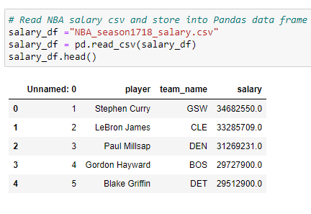
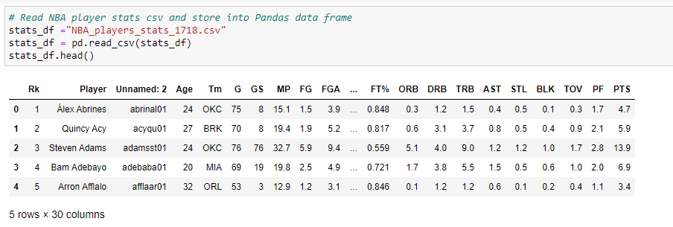
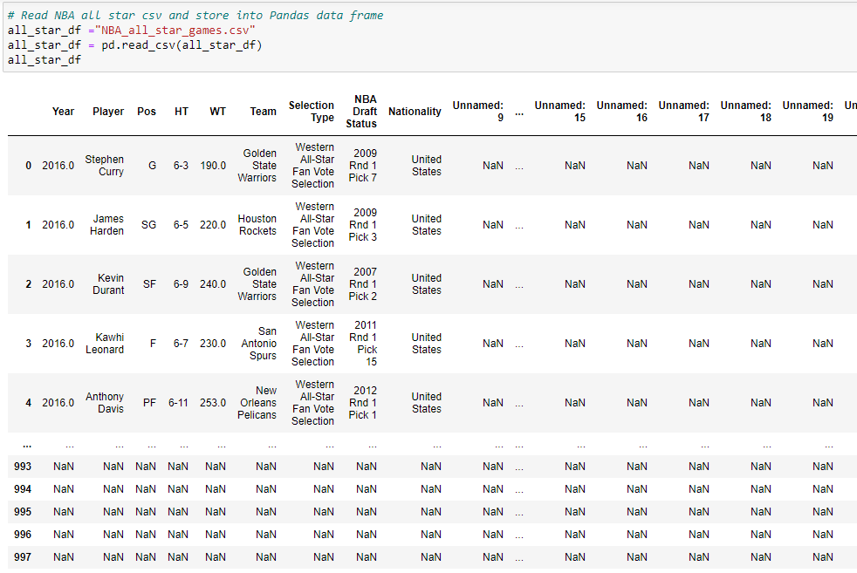
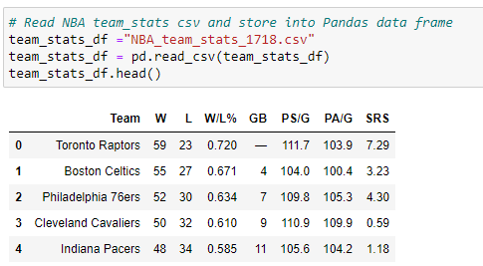
Our Data Consists of 4 Datasets - Extracting
salary_df
stats_df
all_star_df
team_stats_df
Notes:
Our four datasets consist of data on player salary, player stats, team stats, and data on all star game picks. We focused specifically on the 2017-18 season so our datasets were specific to that year.

Slide 6
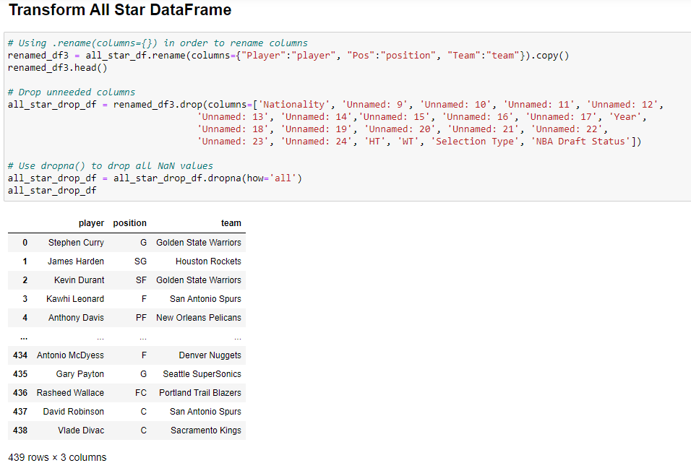
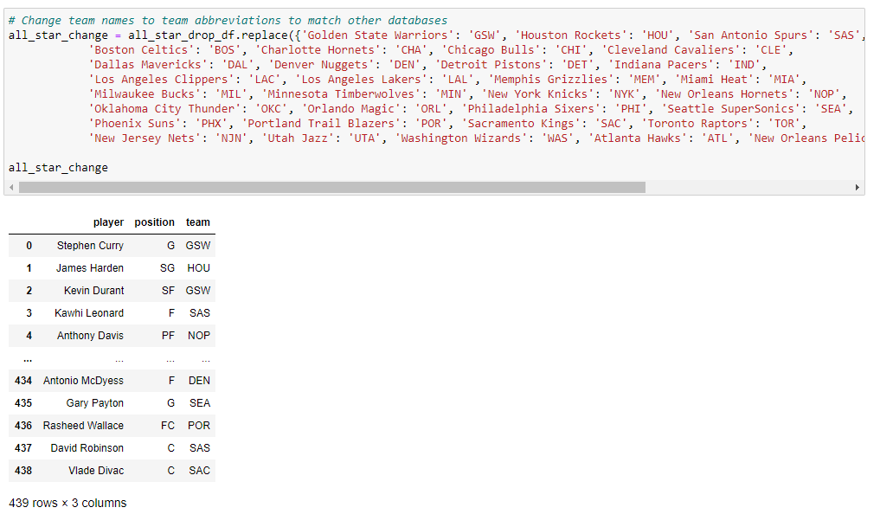
Transforming the Data
1.
2.

Slide 7
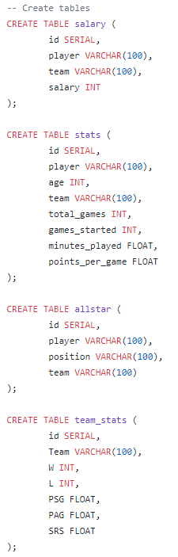
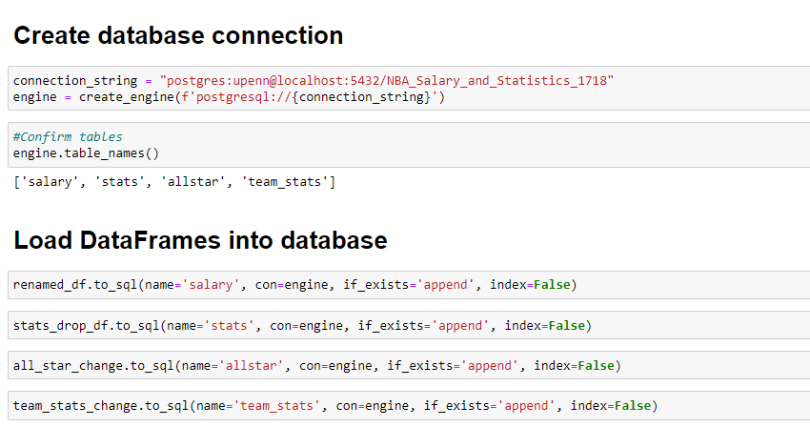
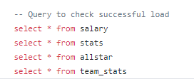
Loading Data into PostgreSQL

Slide 8

Querying the data

Slide 9
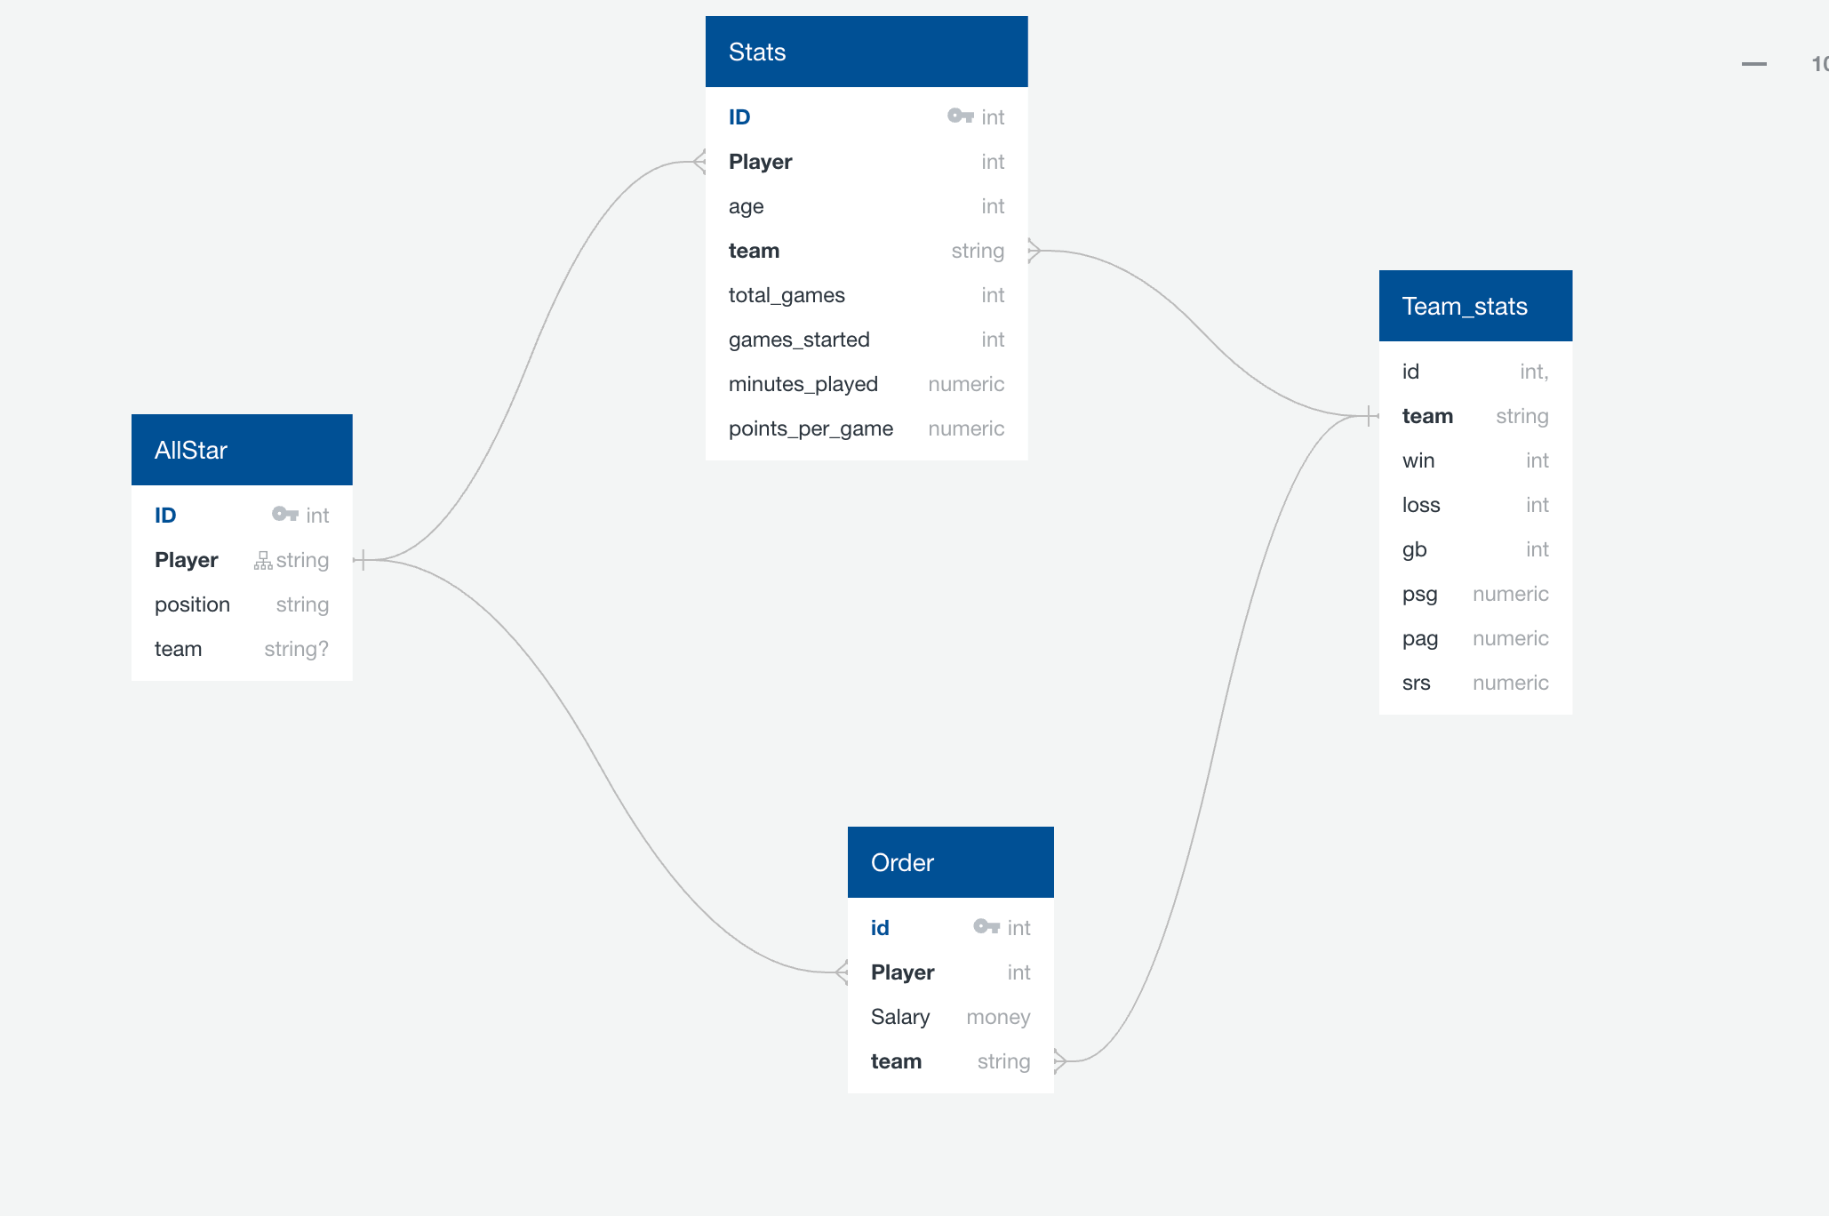
ERD – Finding Relationships

Slide 10
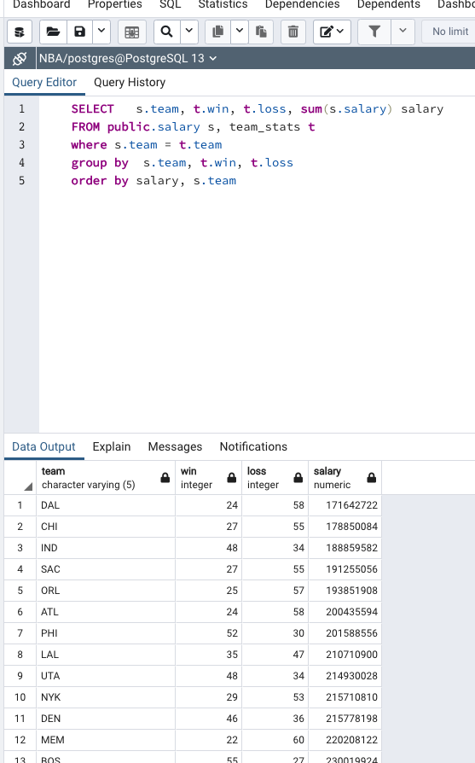
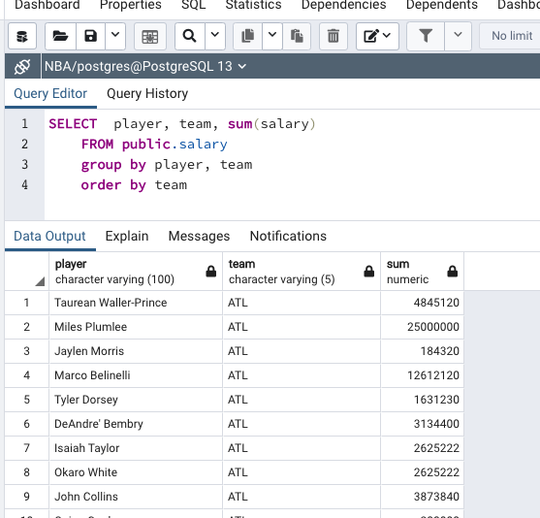
A Look at Some of Our Queries

Slide 11

Creating the flask

Slide 12
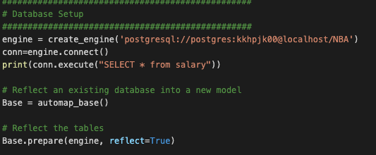
Step 1: Set up database connection to PostgreSQL

Slide 13
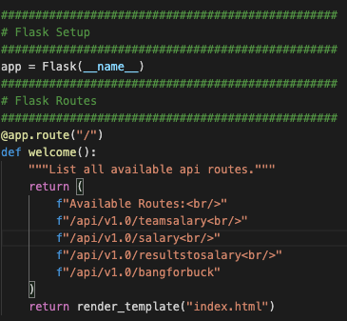
Step 2: Flask set up and Flask routes

Slide 14
Step 2a: for each route
Made the connection
Queried the data
Put it in a dictionary and then appended it to a list and then jsonified that list

Slide 15
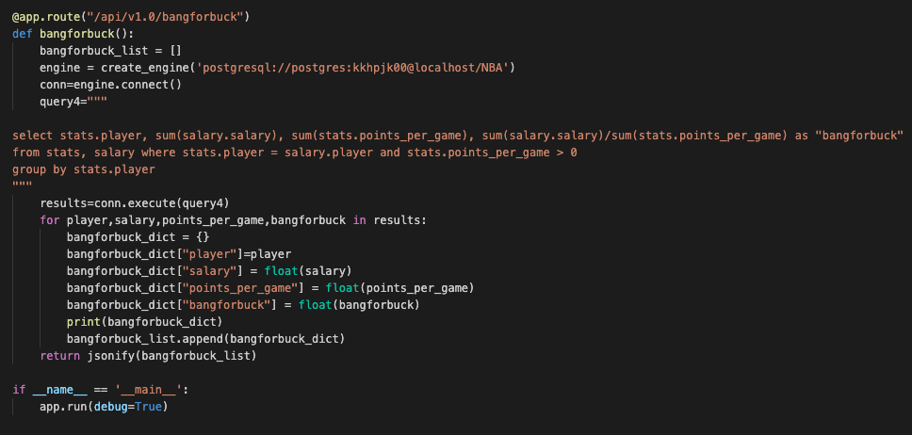
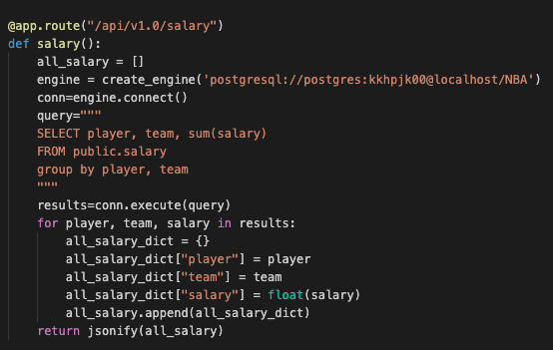
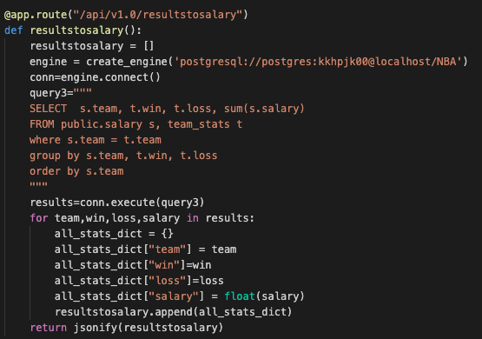
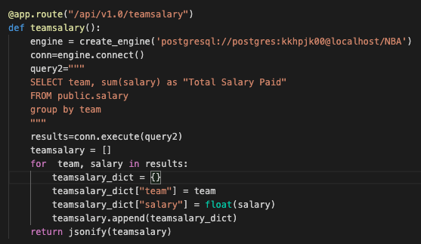
The code

Slide 16
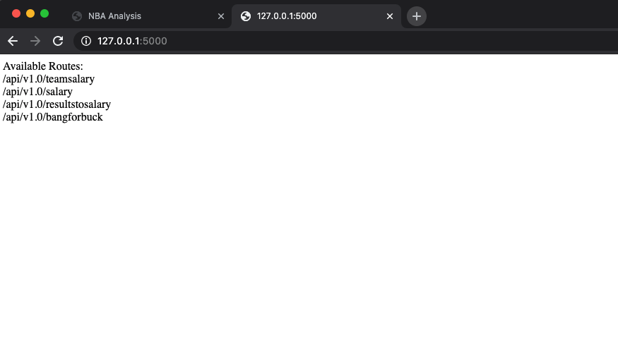
flask End result

Slide 17


Visualizations

Slide 18
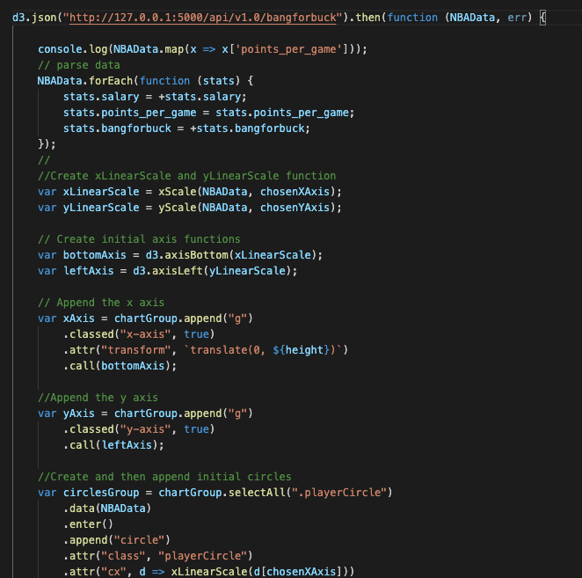
Most important and hardest part – using API Route to feed our data
*we weren’t running it on our API server for so long

Slide 19

The final visualization

Slide 20

Summary

Slide 21
Disclaimer- Our data for all-stars spans the most years from 2000-2016 while our data for data for all other data sets focused on the 2017-18 season.
From our visualizations, we did see a positive but weak correlation between how many points a player made vs their salary. The more points, the higher they seemed to get paid. But could we really say that there was a "bang for buck" value for these players? Not so much.
But what we did see was that MIA had the most players sent to the all-star team and we found Boston and Detroit present in both analysis charts.
The top paid players in the NBA belong to the Golden State Warriors and Cleveland Cavaliers.

Slide 22

To be honest…

Slide 23
Our struggles
Not enough time to thoroughly incorporate an additional d3 library
Bubbles on graph pulling accurate data
Bolded axis on graph
Staying on the storyline

Slide 24

Thank you for your time and patience
Any questions?

